Slide 1
Unit-II
Classification: The problem of classification - Feature engineering - Training and testing classifier models - Statistical decision theory. Classifiers: Naïve Bayes classification - Bayesian networks - Decision Tree Classifier - Random Forest Classifier - K-Nearest Neighbor classification - Support Vector Machines. Artificial Neural Networks: Perceptron - Multilayer Networks and Backpropagation - Applications - Bagging and Boosting - Cross-validation - Model evaluation.

Slide 2
The problem of classification
A classification problem in machine learning is one where you categorize data instances into discrete labels or classes (e.g. “spam” vs. “not spam,” or “disease” vs. “no disease”).
It differs from regression, which predicts continuous outcomes. Classification tasks include both binary and multinomial cases, with outputs often represented as hard assignments or probabilities

Slide 3
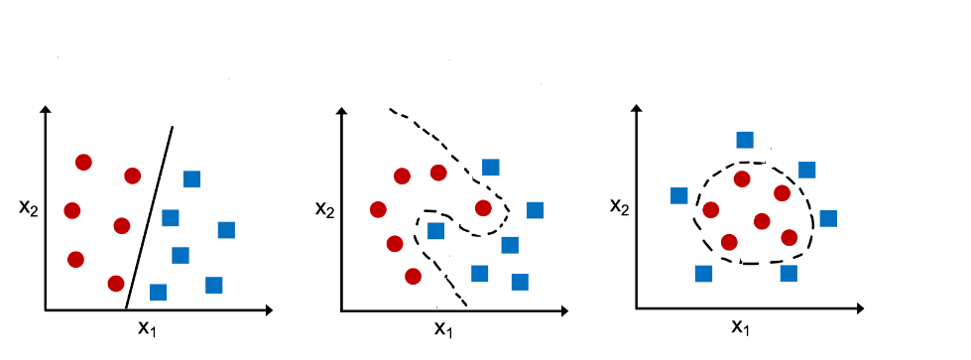
🧠 Types of Classification
Binary classification: Two categories (e.g., yes/no, high/low risk)
Multinomial (Multiclass) classification: Three or more classes (e.g., categorizing documents into topics)
Both types can produce either hard labels or class probability distributions

Slide 4
Machine learning algorithms for solving Classification Problems
Logistic regression
Decision trees
Random forest
XGBoost
Light GBM
Voting classifiers
Artificial neural networks

Slide 5
Classification Problems & Models Examples
✅ Customer Behavior Prediction
Classify customers based on:
Buying patterns
Web browsing behavior
Example use case:
Predict if a customer is likely to make more purchases
Action based on prediction:
Send promotional offers or discounts
If predicted to stop purchasing, mark for re-engagement campaigns

Slide 6
Document Classification
Multinomial classification used to categorize documents into different labels
Algorithms commonly used:
Naive Bayes
Support Vector Machines (SVM)
Neural Networks
Advanced models:
Deep Boltzmann Machines (DBMs)
Deep Belief Networks (DBNs)
Stacked Autoencoders (SAEs)
Applications:
Email sorting, topic detection, automated document tagging

Slide 7
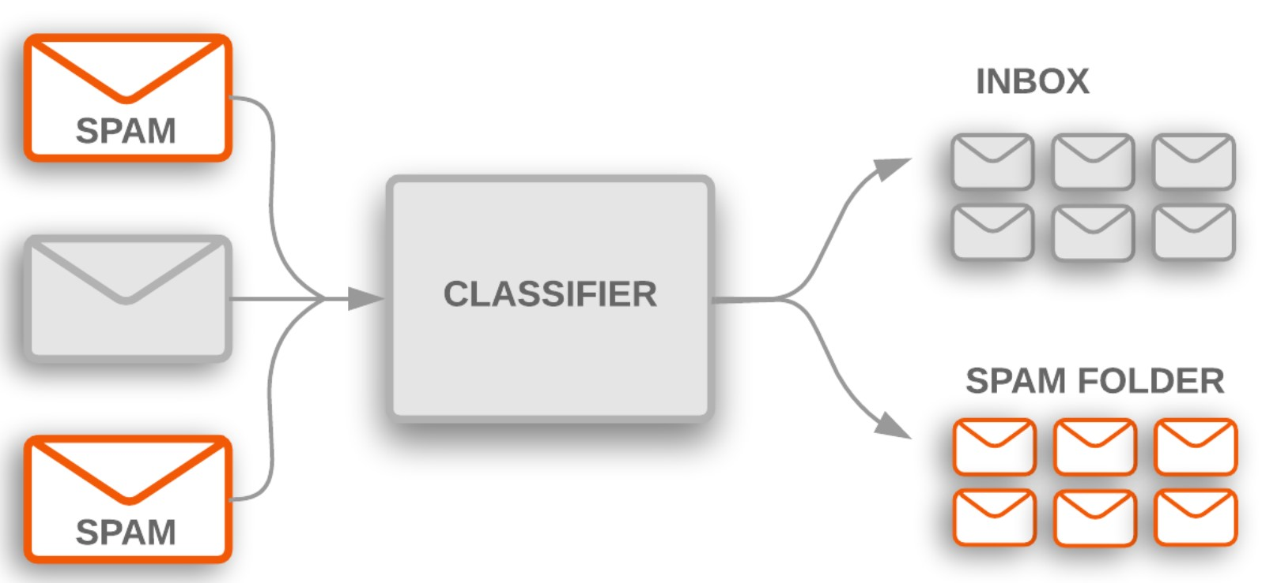
Spam Filtering
Trains a model to classify emails as spam or not spam
Learns from characteristics of spam messages (keywords, patterns)
Model maps email text → spam or non-spam label
Common algorithms:
Naive Bayes
SVM
Use case:
Automatically filter incoming emails to inbox or spam folder

Slide 8
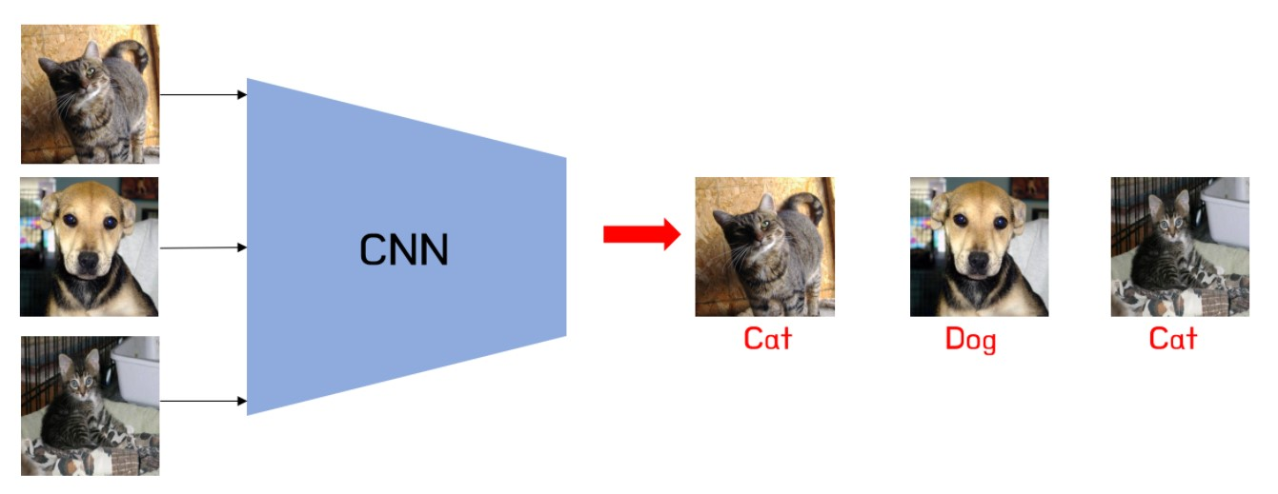
🖼️ Image Classification
Goal: Identify the object or scene in a digital image (e.g., cat, car, human)
Images are treated as high-dimensional vectors
A multinomial classification model maps these vectors to specific categories
Example:
Classifying dog and cat images in machine vision systems
State-of-the-art approach:
Convolutional Neural Networks (CNNs)
Advanced use case:
Image Segmentation:
Assigns labels to each pixel in the image
Defines meaningful image regions based on visual features

Slide 9
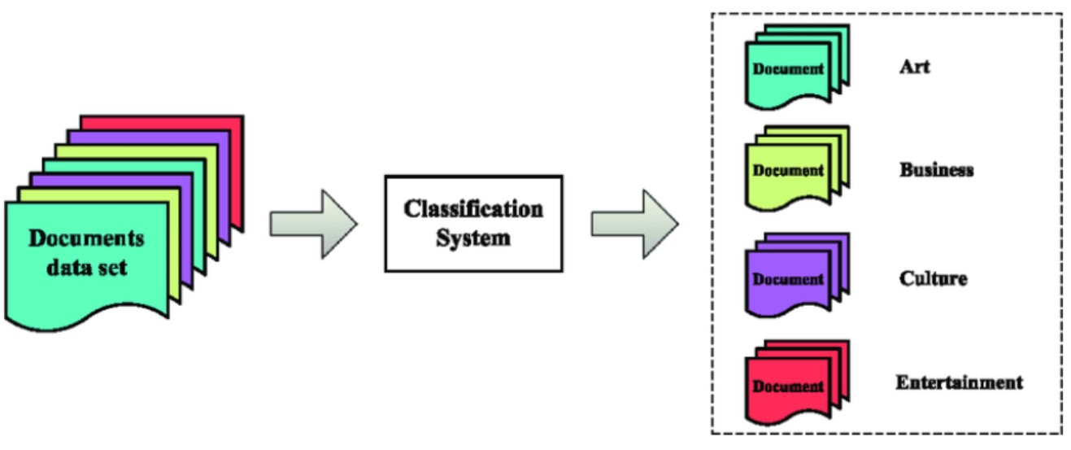
🌐 Web Text Classification
Task: Categorize web documents into topic labels (e.g., Sports, Tech, Entertainment)
Classification model maps:
Text document → Topic category
Used for:
Automatic web tagging
Content filtering
News aggregation (e.g., Google News)
Algorithms:
Naive Bayes (traditional)
Deep Learning Models (modern; better accuracy)

Slide 10
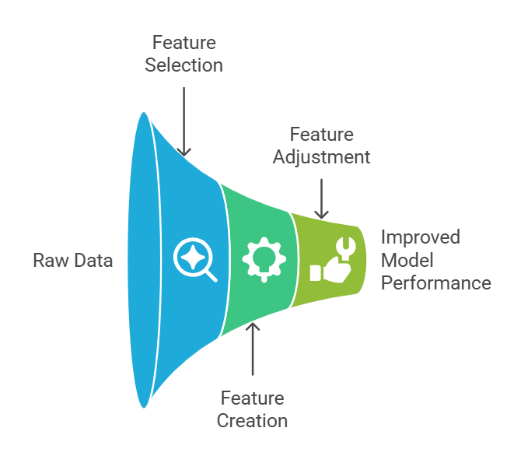
Feature Engineering
What is Feature Engineering?
Process of turning raw data into meaningful input for ML models
Involves choosing, creating, and adjusting features
Goal: Improve model performance and accuracy

Slide 11
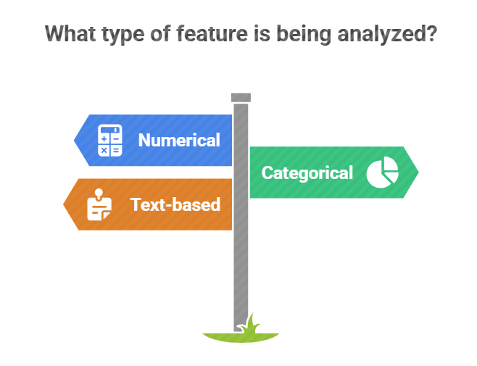
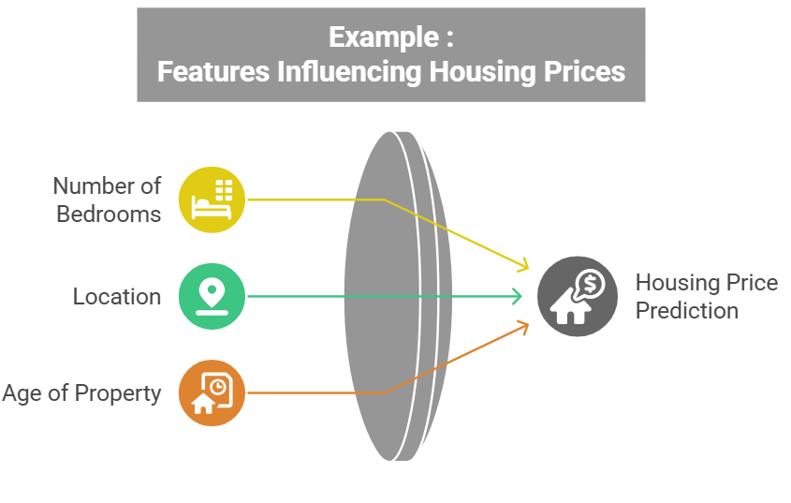

Slide 12
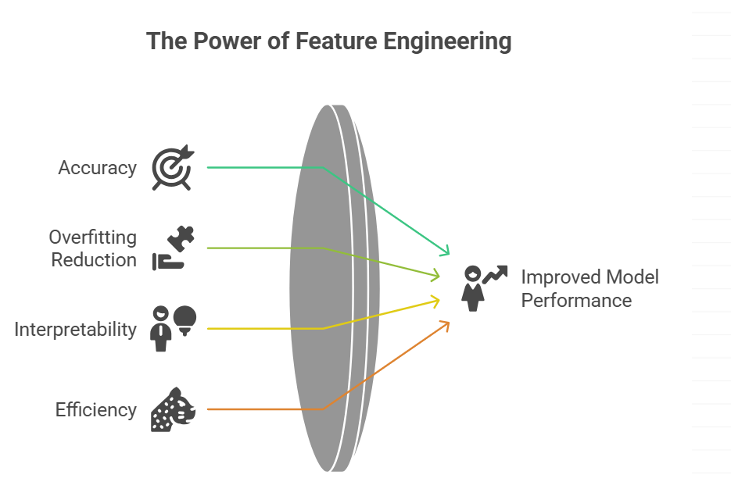

Slide 13
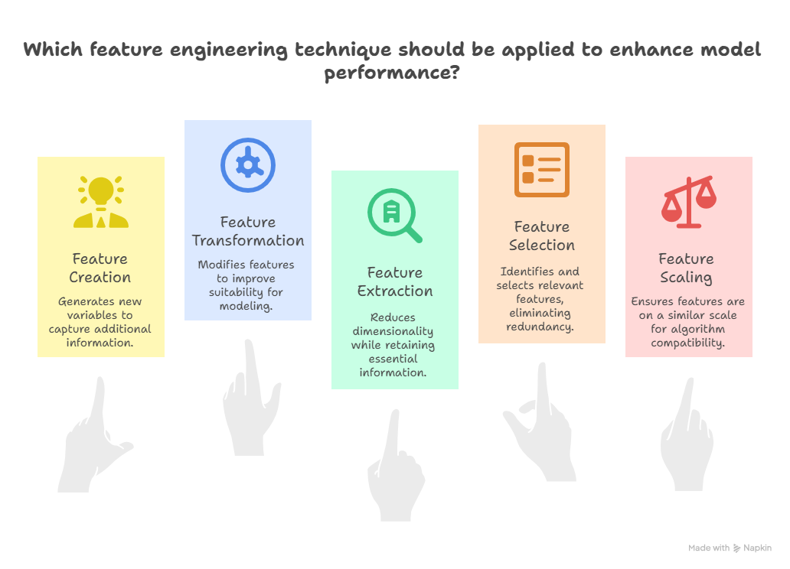

Slide 14
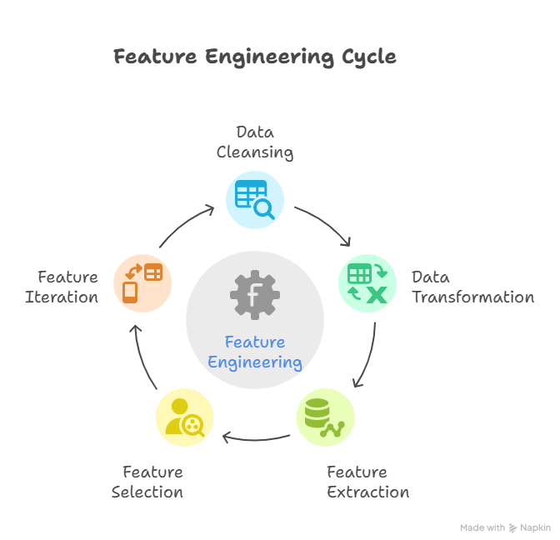

Slide 15
Steps in Feature Engineering
Data Cleansing: Identify and correct errors or inconsistencies in the dataset to ensure data quality and reliability.
Data Transformation: Transform raw data into a format suitable for modeling including scaling, normalization and encoding.
Feature Extraction: Create new features by combining or deriving information from existing ones to provide more meaningful input to the model.
Feature Selection: Choose the most relevant features for the model using techniques like correlation analysis, mutual information and stepwise regression.
Feature Iteration: Continuously refine features based on model performance by adding, removing or modifying features for improvement.

Slide 16
Statistical Decision Making in Machine Learning
What is decision making in ML?
Role of statistics in choosing optimal outcomes
Applications: fraud detection, diagnostics, recommendation engines

Slide 17
Types of Decisions in ML
Classification vs Regression
Hard vs Soft classification
Probabilistic vs Deterministic decision-making

Slide 18
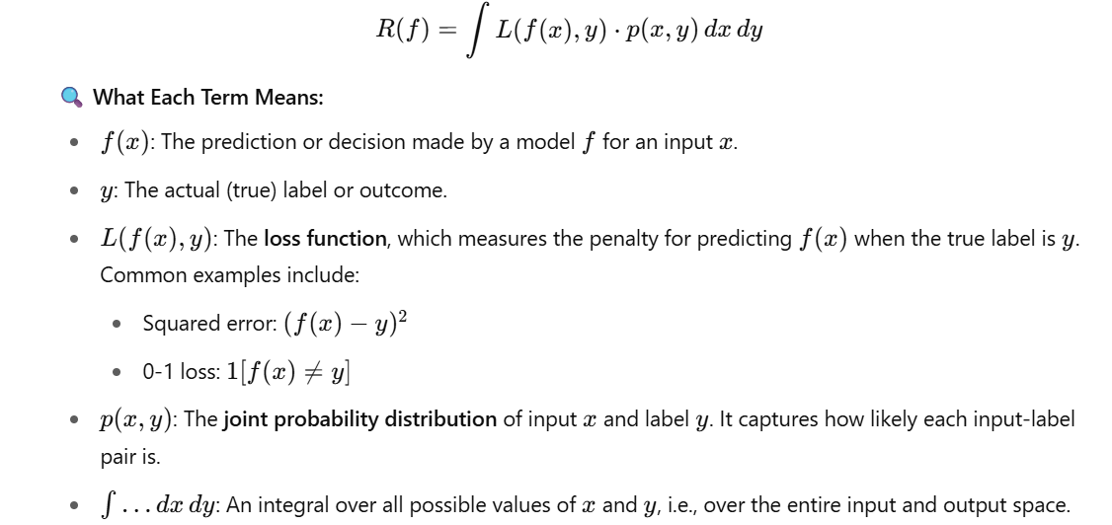
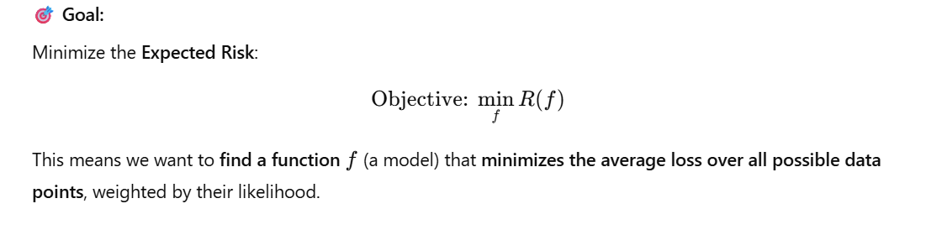
Key Concepts
Hypothesis Space: Set of all models
Decision Function f(x): Predicts outcome from input
Loss Function L(y, ŷ): Measures error in decision
Risk Minimization Principle

Slide 19
Summary
Statistical decision making formalizes ML decisions
Minimizing risk leads to optimal models
Foundation for supervised learning strategies

Slide 20
Classifiers: Naïve Bayes classification - Bayesian networks - Decision Tree Classifier - Random Forest Classifier - K-Nearest Neighbor classification - Support Vector Machines.

Slide 21
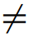
8.3.2 Naive Bayesian Classification
The naive Bayesian classifier, or simple Bayesian classifier, works as follows:
Let D be a training set of tuples and their associated class labels.
As usual, each tuple is represented by an n-dimensional attribute vector, X = (x₁, x₂,..., x_{n}), depicting n measurements made on the tuple from n attributes, respectively, A₁, A₂,..., A_{n}.
Suppose that there are m classes, C₁, C₂,..., C_{m}. Given a tuple, X, the classifier will predict that X belongs to the class having the highest posterior probability, conditioned on X.
That is, the naive Bayesian classifier predicts that tuple X belongs to the class C_{i} if and only if P(C_{i} |X) > P(C_{j} |X) for 1 ≤ j ≤ m, j i.

Slide 22
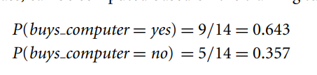
8.3.2 Naive Bayesian Classification
As P(X) is constant for all classes, only P(X|C_{i})P(C_{i}) needs to be maximized.
If the class prior probabilities are not known, then it is commonly assumed that the classes are equally likely,(all have same probability of occurrence) that is, P(C₁) = P(C₂) = ··· = P(C_{m}).
Note that the class prior probabilities may be estimated by P(C_{i}) = |C_{i},D|/|D|, where |C_{i},D| is the number of training tuples of class C_{i} in D.

Slide 23
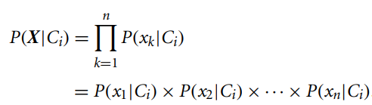
8.3.2 Naive Bayesian Classification
Given data sets with many attributes, it would be extremely computationally expensive to compute P(X|C_{i}).
To reduce computation in evaluating P(X|C_{i}), the naive assumption of class-conditional independence is made.
This presumes that the attributes’ values are conditionally independent of one another, given the class label of the tuple (i.e., that there are no dependence relationships among the attributes).
Thus,

Slide 24
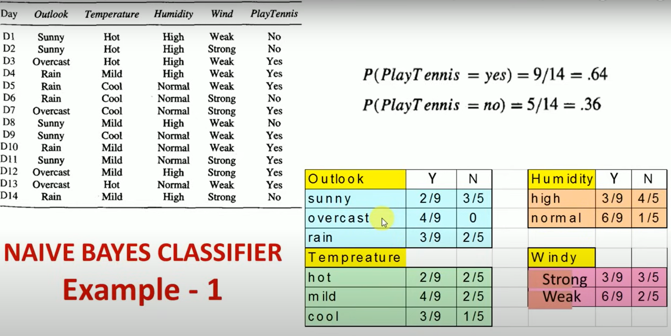

Slide 25
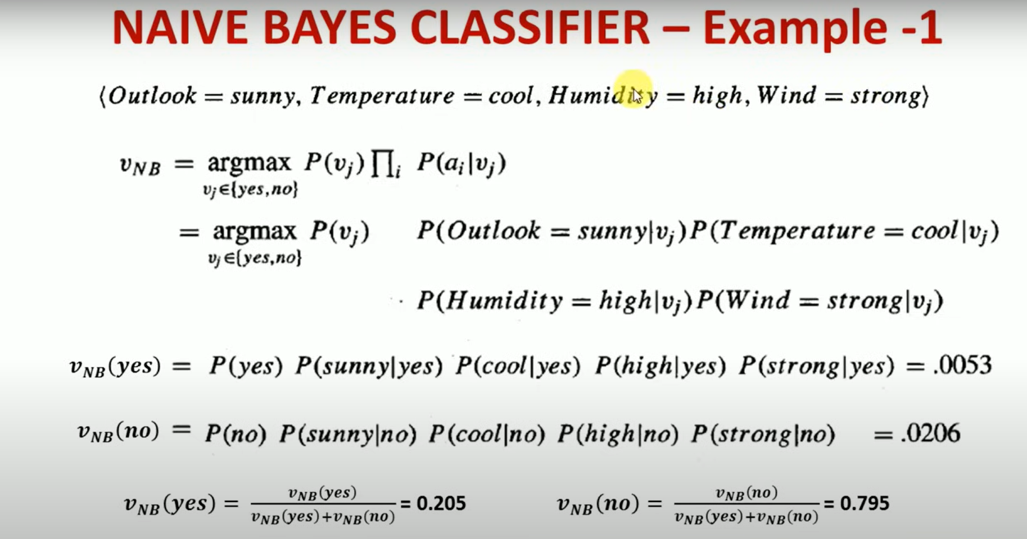

Slide 26
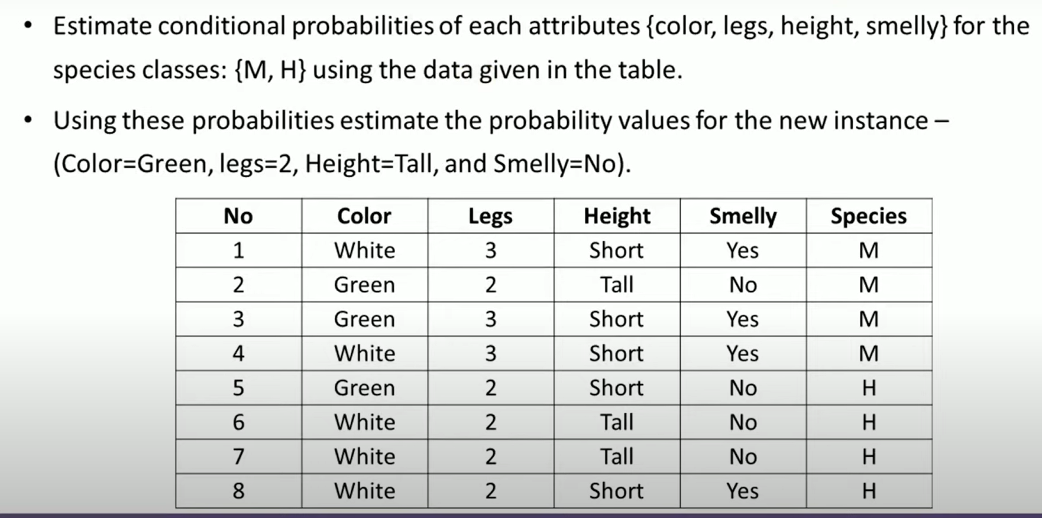

Slide 27
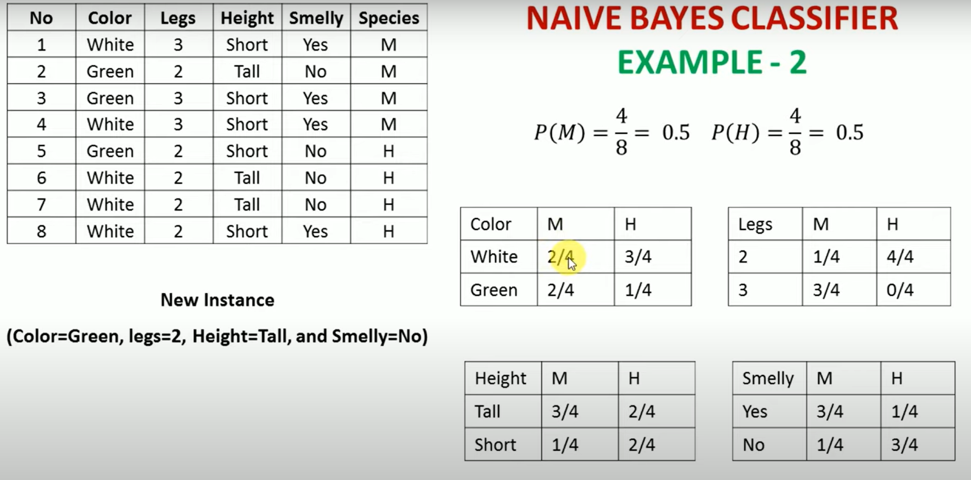

Slide 28
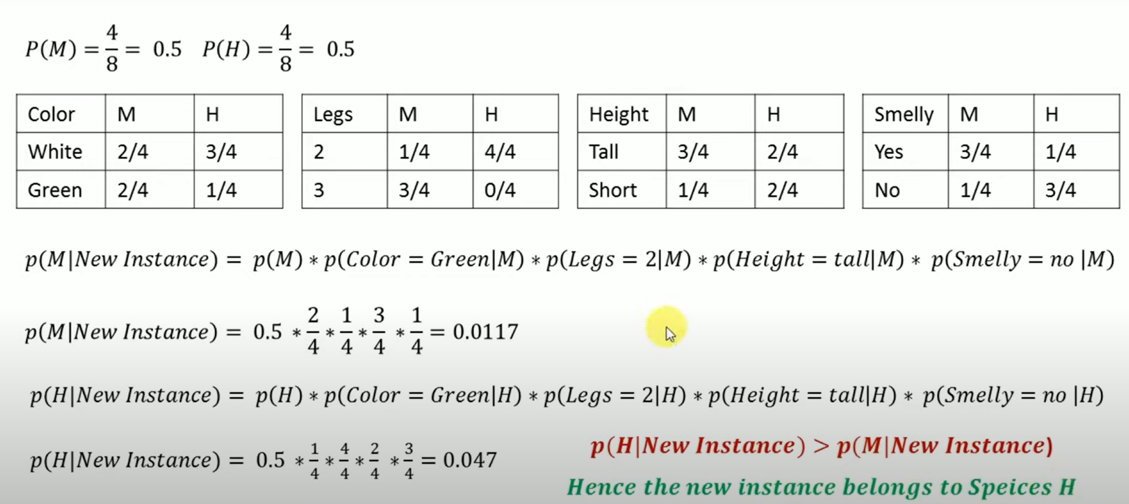

Slide 29
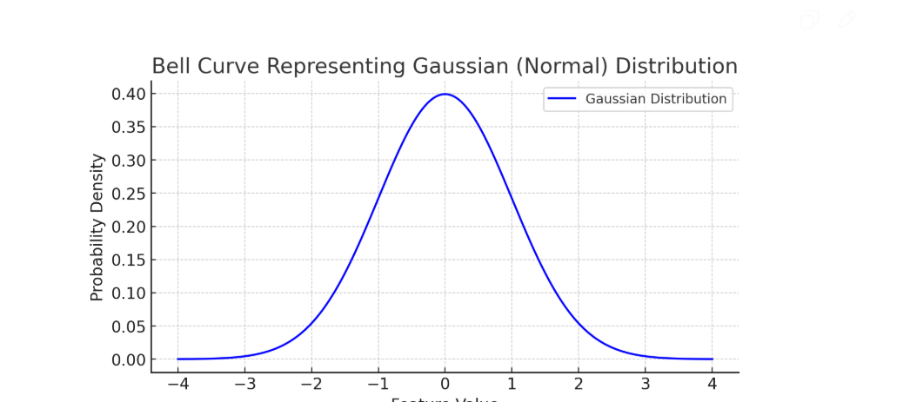
Naïve Bayes vs Gaussian Naïve Bayes
The Naive Bayes classifier is a family of probabilistic classifiers based on Bayes' Theorem with the naive assumption of feature independence.
Data type:Count (discrete)
Gaussian Naive Bayes is a specific type of Naive Bayes classifier that assumes the features follow a normal (Gaussian) distribution.
Data type : Continuous (real-valued)
It assumes that the continuous features follow a normal distribution (bell curve).

Slide 30
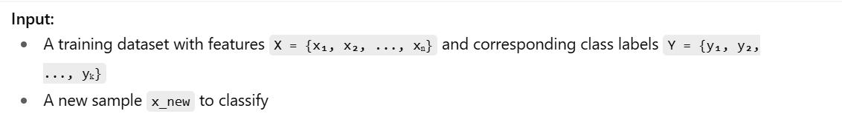
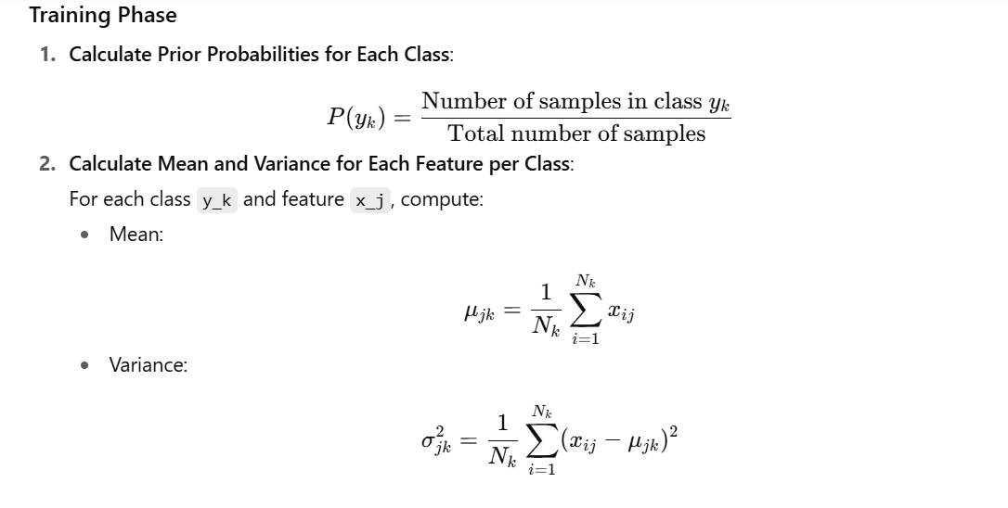
GAUSSIAN NAÏVE BAYES ALGORITHM

Slide 31
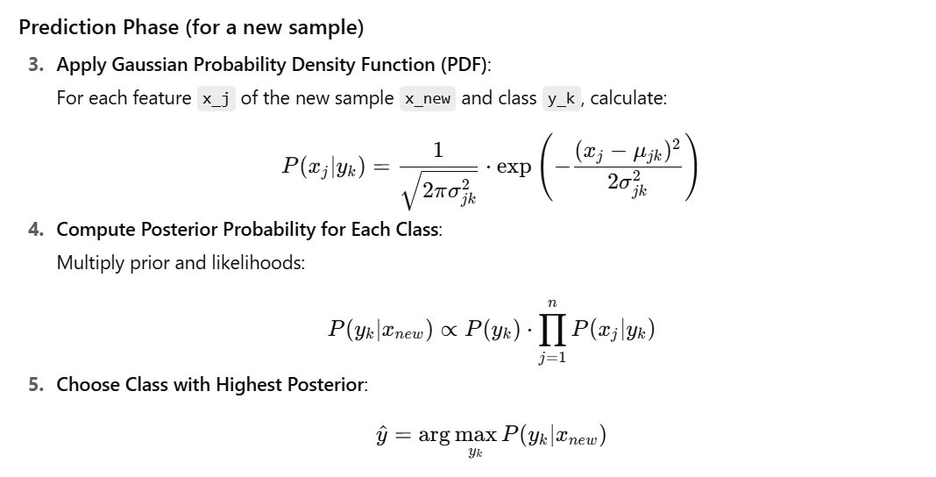

Slide 32
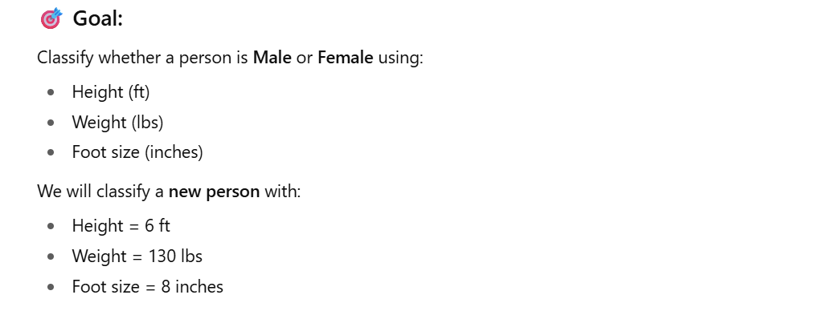

Slide 33
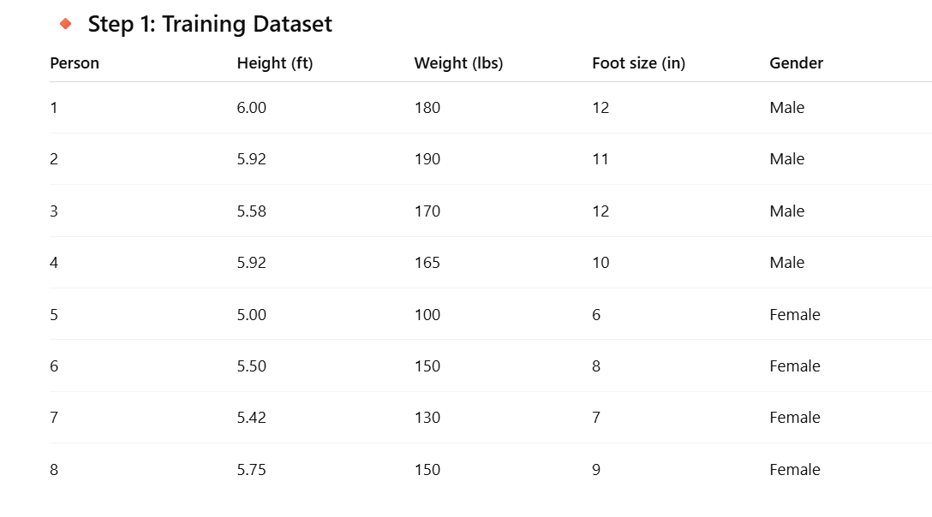

Slide 34
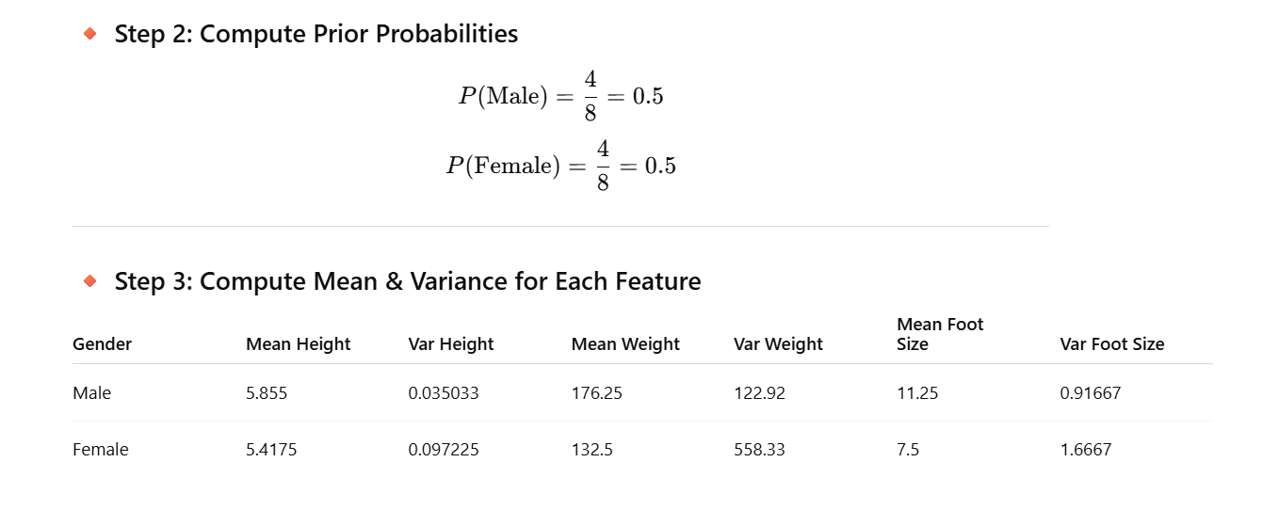

Slide 35
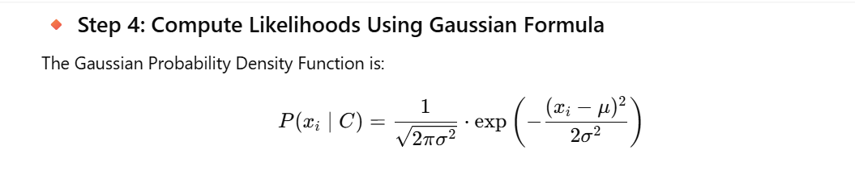
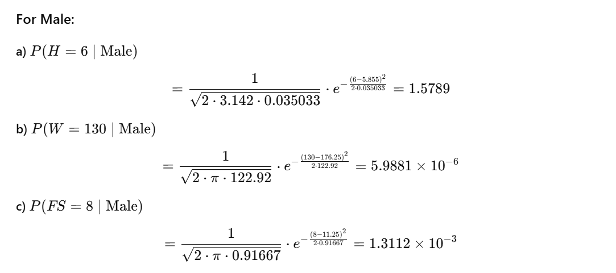

Slide 36
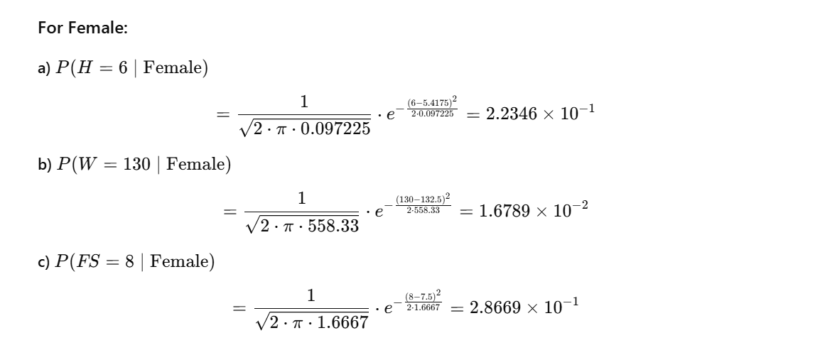

Slide 37
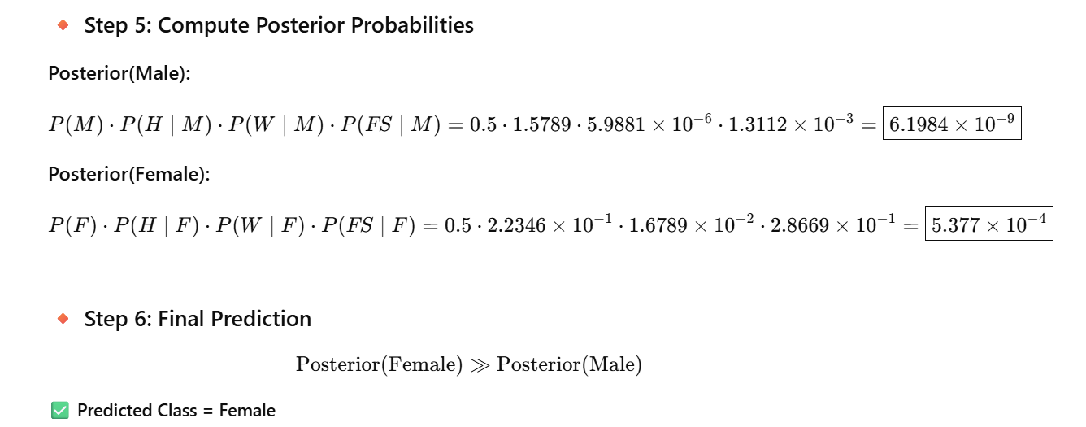

Slide 38
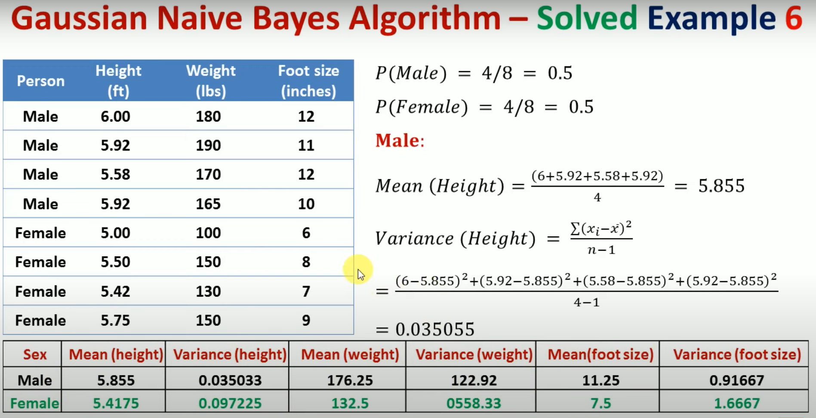

Slide 39
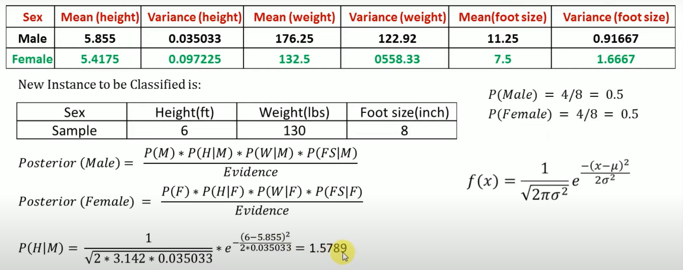

Slide 40
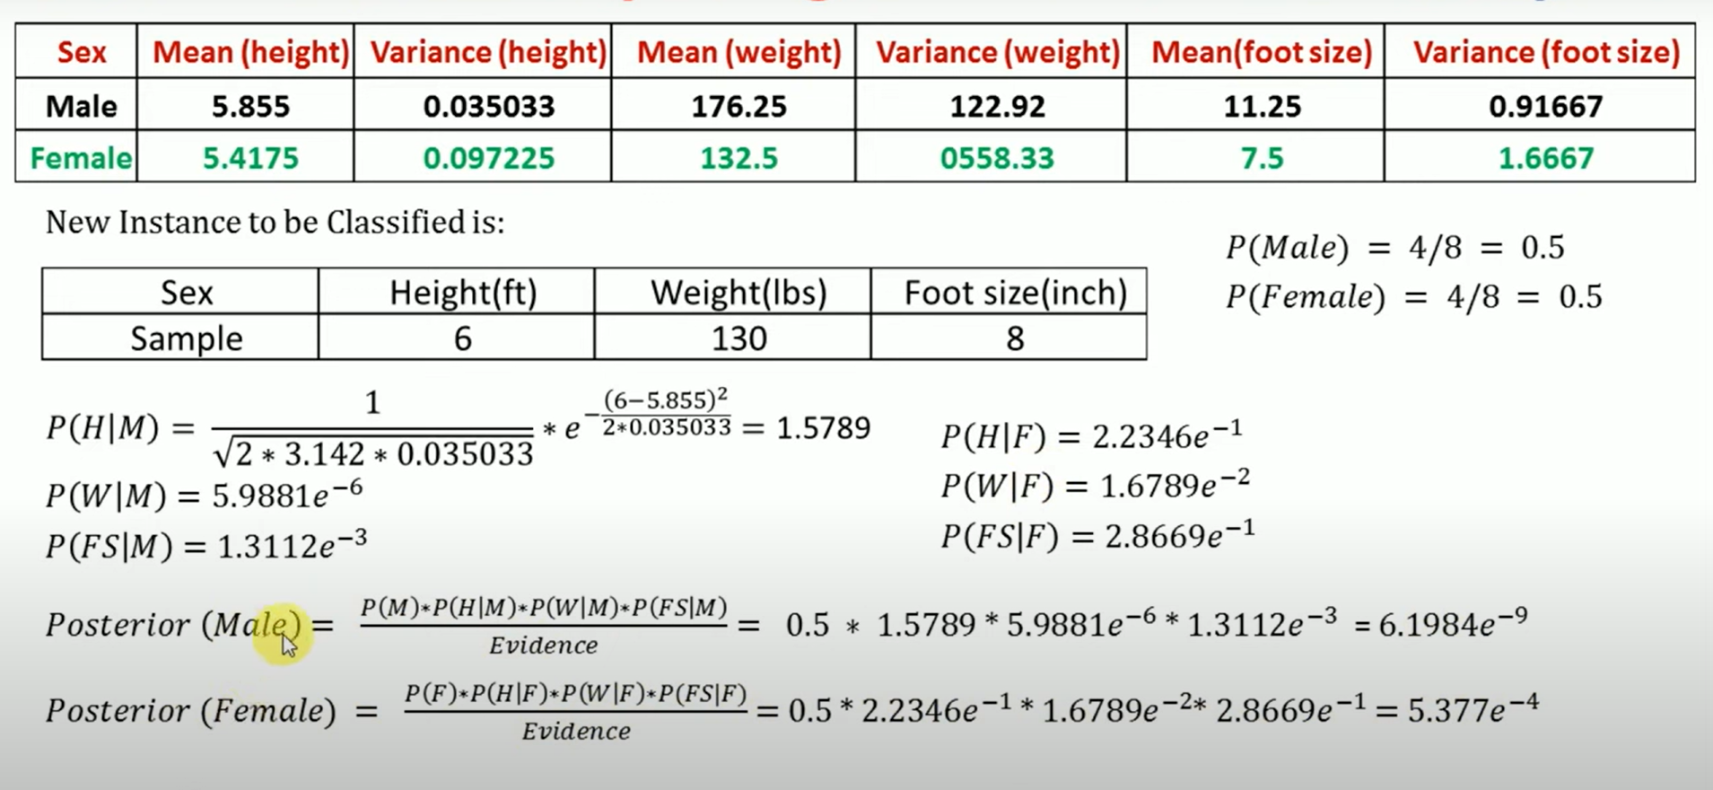

Slide 41
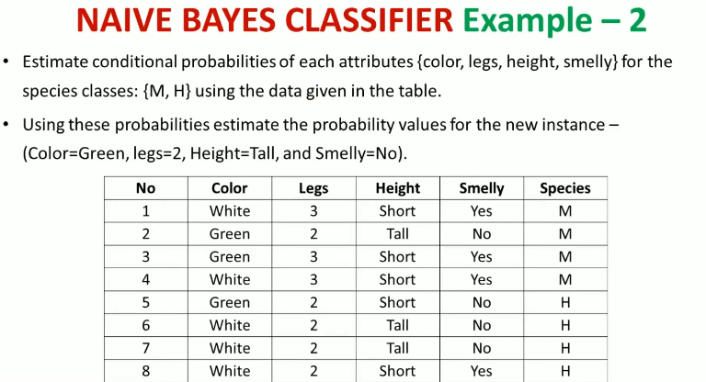
Class work problem

Slide 42
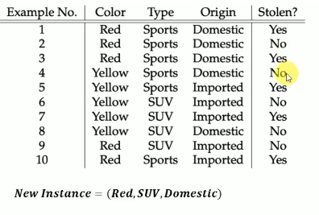

Slide 43
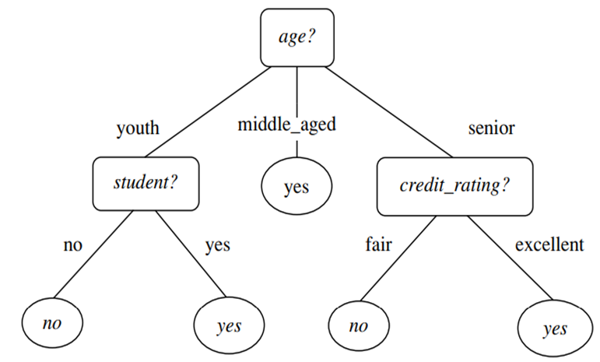
8.2 Decision Tree Induction
Decision tree induction is the learning of decision trees from class-labeled training tuples.
A decision tree is a flowchart-like tree structure, where each internal node (nonleaf node) denotes a test on an attribute, each branch represents an outcome of the test, and each leaf node (or terminal node) holds a class label.
The topmost node in a tree is the root node.
Figure 8.2
A typical decision tree is shown in Figure 8.2. It represents the concept buys computer, that is, it predicts whether a customer at AllElectronics is likely to purchase a computer. Internal nodes are denoted by rectangles, and leaf nodes are denoted by ovals.

Slide 44
8.2 Decision Tree Induction
Some decision tree algorithms produce only binary trees (where each internal node branches to exactly two other nodes), whereas others can produce nonbinary trees.
“How are decision trees used for classification?”
Given a tuple, X, for which the associated class label is unknown, the attribute values of the tuple are tested against the decision tree.
A path is traced from the root to a leaf node, which holds the class prediction for that tuple.
Decision trees can easily be converted to classification rules.

Slide 45
8.2 Decision Tree Induction
“Why are decision tree classifiers so popular?”
The construction of decision tree classifiers does not require any domain knowledge or parameter setting, and therefore is appropriate for exploratory knowledge discovery.
Decision trees can handle multidimensional data.
Their representation of acquired knowledge in tree form is intuitive and generally easy to assimilate by humans.
The learning and classification steps of decision tree induction are simple and fast.
In general, decision tree classifiers have good accuracy.
However, successful use may depend on the data at hand.

Slide 46
8.2 Decision Tree Induction
Decision tree induction algorithms have been used for classification in many application areas such as medicine, manufacturing and production, financial analysis, astronomy, and molecular biology.
Decision trees are the basis of several commercial rule induction systems.

Slide 47
8.2.1 Decision Tree Induction
During the late 1970s and early 1980s, J. Ross Quinlan, a researcher in machine learning, developed a decision tree algorithm known as ID3 (Iterative Dichotomiser).
This work expanded on earlier work on concept learning systems, described by E. B. Hunt, J. Marin, and P. T. Stone.
Quinlan later presented C4.5 (a successor of ID3), which became a benchmark to which newer supervised learning algorithms are often compared.
In 1984, a group of statisticians (L. Breiman, J. Friedman, R. Olshen, and C. Stone) published the book Classification and Regression Trees (CART), which described the generation of binary decision trees.
ID3 and CART were invented independently of one another at around the same time, yet follow a similar approach for learning decision trees from training tuples.
These two cornerstone algorithms spawned a flurry of work on decision tree induction.

Slide 48
8.2.1 Decision Tree Induction
The strategy is as follows.
The algorithm is called with three parameters:
D, attribute list, and Attribute selection method.
We refer to D as a data partition.
Initially, it is the complete set of training tuples and their associated class labels.
The parameter attribute list is a list of attributes describing the tuples.
Attribute selection method specifies a heuristic procedure for selecting the attribute that “best” discriminates the given tuples according to class.

Slide 49
8.2.1 Decision Tree Induction
This procedure employs an attribute selection measure such as information gain or the Gini index.
Whether the tree is strictly binary is generally driven by the attribute selection measure.
Some attribute selection measures, such as the Gini index, enforce the resulting tree to be binary.
Others, like information gain, do not, therein allowing multiway splits (i.e., two or more branches to be grown from a node).

Slide 50
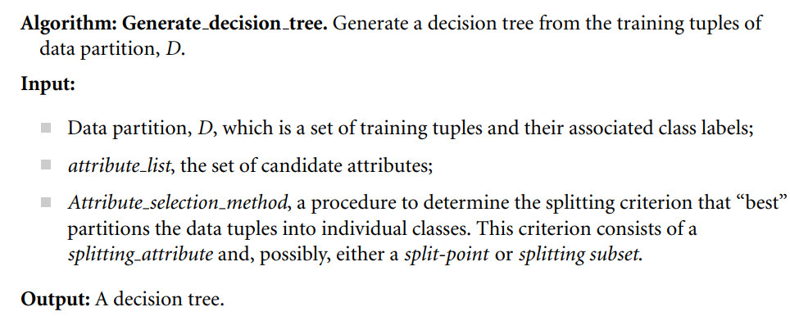
8.2.1 Decision Tree Induction

Slide 51
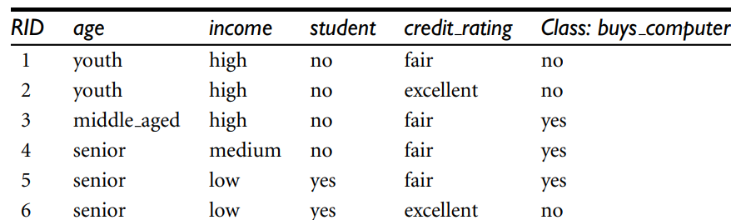

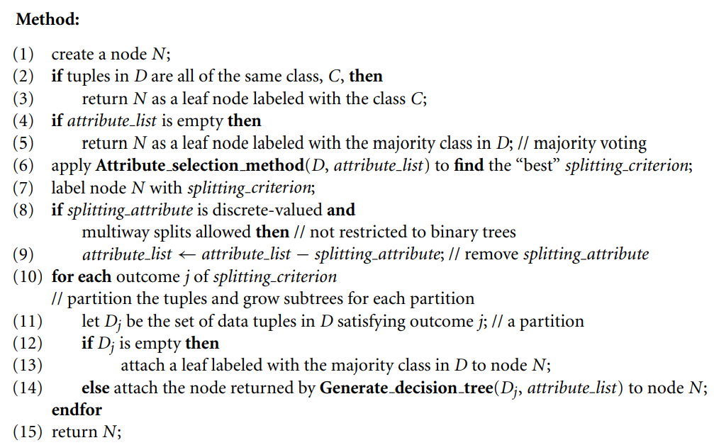
8.2.1 Decision Tree Induction

Slide 52
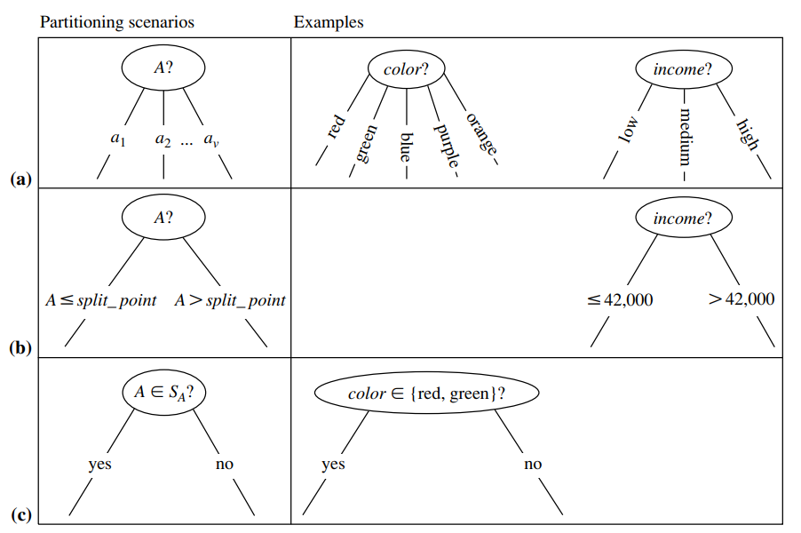
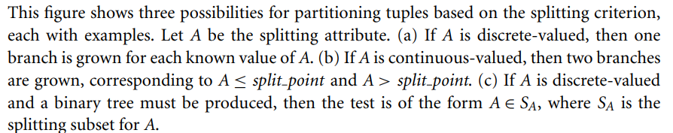
8.2.1 Decision Tree Induction

Slide 53
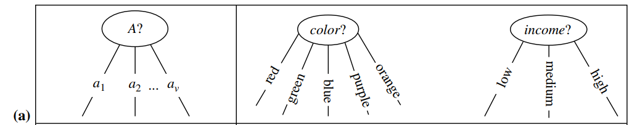
8.2.1 Decision Tree Induction
There are three possible scenarios, as illustrated in Figure 8.4.
Let A be the splitting attribute.
A has v distinct values, {a1, a2,..., av }, based on the training data.
A is discrete-valued: In this case, the outcomes of the test at node N correspond directly to the known values of A.
A branch is created for each known value, aj , of A and labeled with that value (Figure 8.4a). Partition Dj is the subset of class-labeled tuples in D having value aj of A.
A need not be considered in any future partitioning of the tuples. Therefore, it is removed from attribute list (steps 8 and 9)

Slide 54
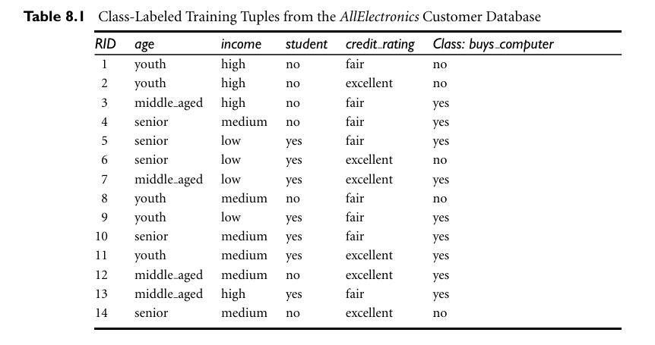

Slide 55
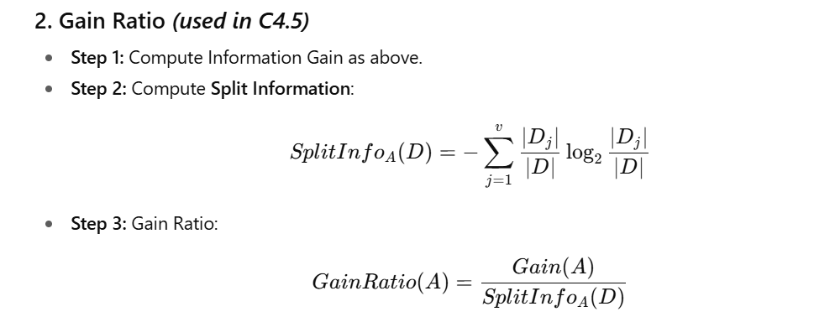
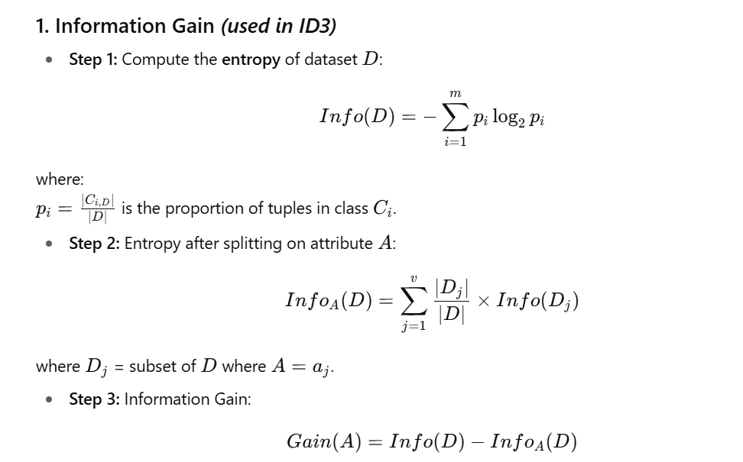
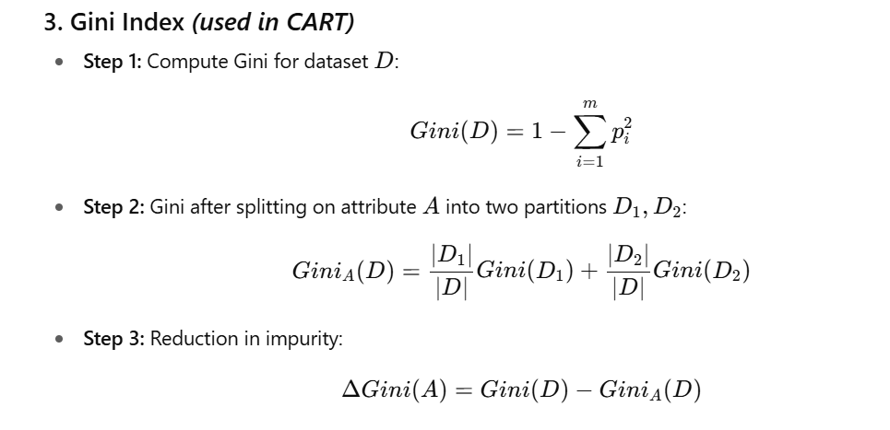
ATTRIBUTE SELECTION METHODS

Slide 56
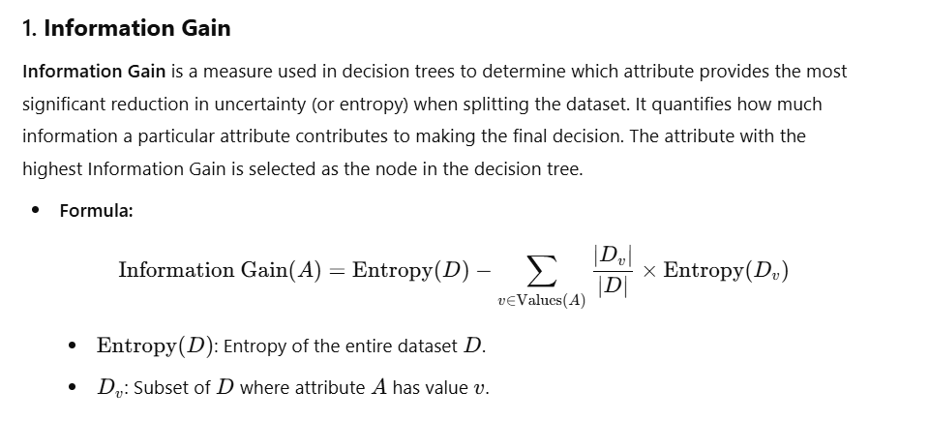

Slide 57
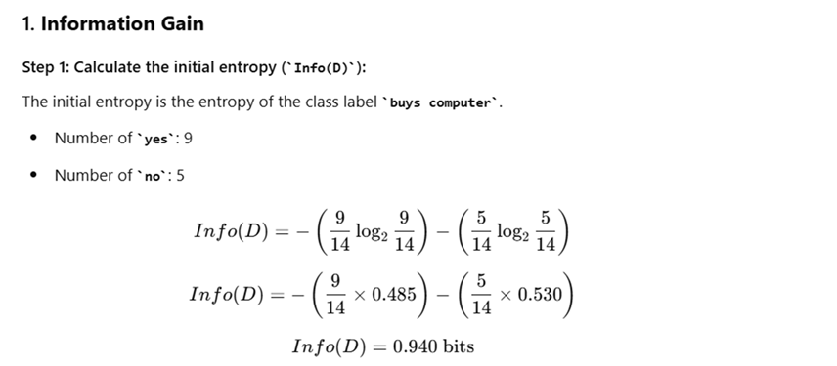

Slide 58
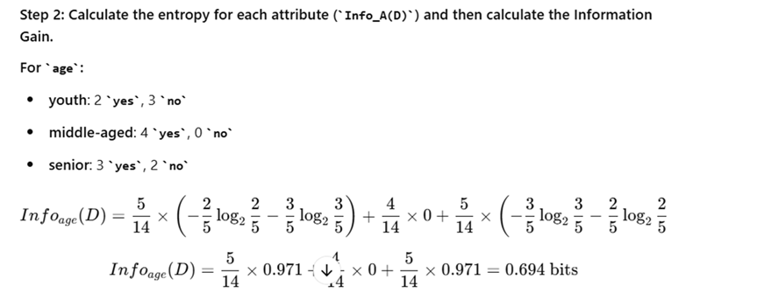

Yes
No
5 youth
4 Middle age
5 senior

Slide 59


Slide 60

Age has the highest information gain among the attribute and its is selected as the splitting attributes.

Slide 61


8.2.1 Decision Tree Induction
2.Gain Ratio
This value represents the potential information generated by splitting the training data set, D, into v partitions, corresponding to the v outcomes of a test on attribute A.
Note that, for each outcome, it considers the number of tuples having that outcome with respect to the total number of tuples in D.
The gain ratio is defined as
The attribute with the maximum gain ratio is selected as the splitting attribute.
Note, however, that as the split information approaches 0, the ratio becomes unstable.

Slide 62

8.2.1 Decision Tree Induction
Example 8.2 Computation of gain ratio for the attribute income.
A test on income splits the data of Table 8.1 into three partitions, namely low, medium, and high, containing four, six, and four tuples, respectively.
To compute the gain ratio of income, we first use Eq. (8.5) to obtain
For income ( Low) attribute 4/14
For medium 6/14
For high 4/14

Slide 63


Slide 64



Slide 65



Slide 66

K-Nearest Neighbor Algorithm
K-Nearest Neighbors (KNN) is a supervised machine learning algorithm generally used for classification but can also be used for regression tasks. It works by finding the "k" closest data points (neighbors) to a given input and makes a predictions based on the majority class (for classification) or the average value (for regression). Since KNN makes no assumptions about the underlying data distribution it makes it a non-parametric and instance-based learning method.

Slide 67

Distance Metrics Used in KNN Algorithm
Distance Metrics Used in KNN Algorithm
KNN uses distance metrics to identify nearest neighbor, these neighbors are used for classification and regression task. To identify nearest neighbor, we use below distance metrics:
1. Euclidean Distance
Euclidean distance is defined as the straight-line distance between two points in a plane or space. You can think of it like the shortest path you would walk if you were to go directly from one point to another.

Slide 68


Distance Metrics Used in KNN Algorithm
2. Manhattan Distance
This is the total distance you would travel if you could only move along horizontal and vertical lines like a grid or city streets. It’s also called "taxicab distance" because a taxi can only drive along the grid-like streets of a city.
3. Minkowski Distance
Minkowski distance is like a family of distances, which includes both Euclidean and Manhattan distances as special cases.
From the formula above, when p=2, it becomes the same as the Euclidean distance formula and when p=1, it turns into the Manhattan distance formula. Minkowski distance is essentially a flexible formula that can represent either Euclidean or Manhattan distance depending on the value of p.

Slide 69

Working of KNN algorithm
Thе K-Nearest Neighbors (KNN) algorithm operates on the principle of similarity where it predicts the label or value of a new data point by considering the labels or values of its K nearest neighbors in the training dataset.

Slide 70
Steps
Step 1: Selecting the optimal value of K
K represents the number of nearest neighbors that needs to be considered while making prediction.
Step 2: Calculating distance
To measure the similarity between target and training data points Euclidean distance is used. Distance is calculated between data points in the dataset and target point.
Step 3: Finding Nearest Neighbors
The k data points with the smallest distances to the target point are nearest neighbors.
Step 4: Voting for Classification or Taking Average for Regression
When you want to classify a data point into a category like spam or not spam, the KNN algorithm looks at the K closest points in the dataset. These closest points are called neighbors. The algorithm then looks at which category the neighbors belong to and picks the one that appears the most. This is called majority voting.
In regression, the algorithm still looks for the K closest points. But instead of voting for a class in classification, it takes the average of the values of those K neighbors. This average is the predicted value for the new point for the algorithm.

Slide 71

Lazy Classifier- KNN (Problem)
k-nearest neighbor approach
Instances represented as points in a Euclidean space.

Slide 72


Slide 73


Slide 74


Slide 75


Slide 76


Slide 77

Classwork Problem

Slide 78
Applications of KNN
Recommendation Systems: Suggests items like movies or products by finding users with similar preferences.
Spam Detection: Identifies spam emails by comparing new emails to known spam and non-spam examples.
Customer Segmentation: Groups customers by comparing their shopping behavior to others.
Speech Recognition: Matches spoken words to known patterns to convert them into text.
Advantages of KNN
Simple to use: Easy to understand and implement.
No training step: No need to train as it just stores the data and uses it during prediction.
Few parameters: Only needs to set the number of neighbors (k) and a distance method.
Versatile: Works for both classification and regression problems.
Disadvantages of KNN
Slow with large data: Needs to compare every point during prediction.
Struggles with many features: Accuracy drops when data has too many features.
Can Overfit: It can overfit especially when the data is high-dimensional or not clean.

Slide 79
Classification: A Mathematical Mapping
Classification: predicts categorical class labels
E.g., Personal homepage classification
x_{i} = (x₁, x₂, x₃, …), y_{i} = +1 or –1
x₁ : # of word “homepage”
x₂ : # of word “welcome”
Mathematically, x ∈ X = ℜ^{n}, y ∈ Y = {+1, –1},
We want to derive a function f: X → Y
Linear Classification
Binary Classification problem
Data above the red line belongs to class ‘x’
Data below red line belongs to class ‘o’
Examples: SVM, Perceptron, Probabilistic Classifiers
x
x
x
x
x
x
x
x
x
o
o
x
o
o
o
o
o
o
o
o
o
o
o
79
Notes:
79

Slide 80
Discriminative Classifiers
Advantages
Prediction accuracy is generally high
As compared to Bayesian methods – in general
Robust, works when training examples contain errors
Fast evaluation of the learned target function
Bayesian networks are normally slow
Criticism
Long training time
Difficult to understand the learned function (weights)
Bayesian networks can be used easily for pattern discovery
Not easy to incorporate domain knowledge
Easy in the form of priors on the data or distributions
80
Notes:
80

Slide 81
SVM—Support Vector Machines
A relatively new classification method for both linear and nonlinear data
It uses a nonlinear mapping to transform the original training data into a higher dimension
With the new dimension, it searches for the linear optimal separating hyperplane (i.e., “decision boundary”)
With an appropriate nonlinear mapping to a sufficiently high dimension, data from two classes can always be separated by a hyperplane
SVM finds this hyperplane using support vectors (“essential” training tuples) and margins (defined by the support vectors)

Slide 82
SVM—History and Applications
Vapnik and colleagues (1992)—groundwork from Vapnik & Chervonenkis’ statistical learning theory in 1960s
Features: training can be slow but accuracy is high owing to their ability to model complex nonlinear decision boundaries (margin maximization)
Used for: classification and numeric prediction
Applications:
handwritten digit recognition, object recognition, speaker identification, benchmarking time-series prediction tests

Slide 83
SVM—General Philosophy
Wx1+b=1
Wx2+b=-1
Small Margin
2/||w||
Large Margin
Support Vectors

Slide 84

Wx1+b=1
(-) (-) (-)
Wx2+b=-1
_________
W(x1-x2)=2
(x1-x2)=2/||w||

Slide 85


Slide 86


Slide 87

SVM—Margins and Support Vectors

Slide 88
SVM—When Data Is Linearly Separable
m
Let data D be (X₁, y₁), …, (X_{|D|}, y_{|D|}), where X_{i} is the set of training tuples associated with the class labels y_{i}
There are infinite lines (hyperplanes) separating the two classes but we want to find the best one (the one that minimizes classification error on unseen data)
SVM searches for the hyperplane with the largest margin, i.e., maximum marginal hyperplane (MMH)

Slide 89
SVM—Linearly Separable
A separating hyperplane can be written as
W ● X + b = 0
where W={w₁, w₂, …, w_{n}} is a weight vector and b a scalar (bias)
For 2-D it can be written as
w₀ + w₁ x₁ + w₂ x₂ = 0
The hyperplane defining the sides of the margin:
H₁: w₀ + w₁ x₁ + w₂ x₂ ≥ 1 for y_{i} = +1, and
H₂: w₀ + w₁ x₁ + w₂ x₂ ≤ – 1 for y_{i} = –1
Any training tuples that fall on hyperplanes H₁ or H₂ (i.e., the sides defining the margin) are support vectors
This becomes a constrained (convex) quadratic optimization problem: Quadratic objective function and linear constraints → Quadratic Programming (QP) → Lagrangian multipliers

Slide 90
Why Is SVM Effective on High Dimensional Data?
The complexity of trained classifier is characterized by the # of support vectors rather than the dimensionality of the data
The support vectors are the essential or critical training examples —they lie closest to the decision boundary (MMH)
If all other training examples are removed and the training is repeated, the same separating hyperplane would be found
The number of support vectors found can be used to compute an (upper) bound on the expected error rate of the SVM classifier, which is independent of the data dimensionality
Thus, an SVM with a small number of support vectors can have good generalization, even when the dimensionality of the data is high

Slide 91

SVM—Linearly Inseparable
Transform the original input data into a higher dimensional space
Search for a linear separating hyperplane in the new space

Slide 92

SVM with Quadratic Kernel
import numpy as np
import matplotlib.pyplot as plt
from sklearn.datasets import make_circles
from sklearn.svm import SVC
# Generate nonlinear data (circle-shaped)
X, y = make_circles(n_samples=200, factor=0.5, noise=0.05)
# Train a linear SVM (will fail to separate properly)
svm_linear = SVC(kernel="linear").fit(X, y)
# Train an SVM with polynomial kernel (degree=2 → quadratic)
svm_poly = SVC(kernel="poly", degree=2, C=10).fit(X, y)
# Plot decision boundaries
def plot_boundary(model, X, y, title):
plt.scatter(X[:, 0], X[:, 1], c=y, cmap="bwr", s=30, edgecolors="k")
ax = plt.gca()
xlim = ax.get_xlim()
ylim = ax.get_ylim()
# create grid
xx, yy = np.meshgrid(np.linspace(xlim[0], xlim[1], 200),
np.linspace(ylim[0], ylim[1], 200))
Z = model.decision_function(np.c_[xx.ravel(), yy.ravel()])
Z = Z.reshape(xx.shape)
# plot decision boundary
plt.contour(xx, yy, Z, colors='k', levels=[0], alpha=0.8, linestyles=['-'])
plt.title(title)
plt.figure(figsize=(10,4))
plt.subplot(1,2,1)
plot_boundary(svm_linear, X, y, "Linear SVM (fails)")
plt.subplot(1,2,2)
plot_boundary(svm_poly, X, y, "Quadratic Kernel SVM (works!)")
plt.show()

Slide 93



Slide 94


Slide 95


Slide 96

SVM: Different Kernel functions
Instead of computing the dot product on the transformed data, it is math. equivalent to applying a kernel function K(X_{i}, X_{j}) to the original data, i.e., K(X_{i}, X_{j}) = Φ(X_{i}) Φ(X_{j})
Typical Kernel Functions
SVM can also be used for classifying multiple (> 2) classes and for regression analysis (with additional parameters)

Slide 97

Random Forest
Random Forest is a machine learning algorithm that uses many decision trees to make better predictions. Each tree looks at different random parts of the data and their results are combined by voting for classification or averaging for regression. This helps in improving accuracy and reducing errors.

Slide 98


Slide 99
Random forest algorithm
Working of Random Forest Algorithm
Create Many Decision Trees: The algorithm makes many decision trees each using a random part of the data. So every tree is a bit different.
Pick Random Features: When building each tree it doesn’t look at all the features (columns) at once. It picks a few at random to decide how to split the data. This helps the trees stay different from each other.
Each Tree Makes a Prediction: Every tree gives its own answer or prediction based on what it learned from its part of the data.
Combine the Predictions:
For classification we choose a category as the final answer is the one that most trees agree on i.e majority voting.
For regression we predict a number as the final answer is the average of all the trees predictions.

Slide 100
Random forest algorithm
Working of Random Forest Algorithm
Create Many Decision Trees: The algorithm makes many decision trees each using a random part of the data. So every tree is a bit different.
Pick Random Features: When building each tree it doesn’t look at all the features (columns) at once. It picks a few at random to decide how to split the data. This helps the trees stay different from each other.
Each Tree Makes a Prediction: Every tree gives its own answer or prediction based on what it learned from its part of the data.
Combine the Predictions:
For classification we choose a category as the final answer is the one that most trees agree on i.e majority voting.
For regression we predict a number as the final answer is the average of all the trees predictions.

Slide 101
Key Features of Random Forest
Handles Missing Data: It can work even if some data is missing so you don’t always need to fill in the gaps yourself.
Shows Feature Importance: It tells you which features (columns) are most useful for making predictions which helps you understand your data better.
Works Well with Big and Complex Data: It can handle large datasets with many features without slowing down or losing accuracy.
Used for Different Tasks: You can use it for both classification like predicting types or labels and regression like predicting numbers or amounts.

Slide 102
Assumptions of Random Forest
Each tree makes its own decisions: Every tree in the forest makes its own predictions without relying on others.
Random parts of the data are used: Each tree is built using random samples and features to reduce mistakes.
Enough data is needed: Sufficient data ensures the trees are different and learn unique patterns and variety.
Different predictions improve accuracy: Combining the predictions from different trees leads to a more accurate final result.

Slide 103


Slide 104

Introduction to Perceptron
Perceptron: the foundation of Artificial Neural Networks
Invented by Frank Rosenblatt (1950s)
Used for supervised learning and binary classification
Consists of:
Input values
Weights & Bias
Net sum
Activation function

Slide 105
What is Perceptron?
A single-layer neural network model
Simplest type of artificial neuron
Performs linear binary classification
Helps detect patterns in input data

Slide 106
Binary Classifier
A function that decides class membership
Input data → vector of numbers
Outputs: belongs to Class A or Class B
Acts as a linear predictor function

Slide 107
Components of Perceptron
Input Nodes – accept numerical values
Weights & Bias – define strength & flexibility
Activation Function – decides output firing

Slide 108

Types of Activation Functions

Slide 109


Slide 110


Slide 111


Slide 112


Slide 113


Slide 114


Slide 115

Working of Perceptron

Slide 116
Types of Perceptron
Single-Layer Perceptron
Simple, linear separability only
Cannot handle XOR-like problems
Multi-Layer Perceptron (MLP)
Includes hidden layers
Uses Backpropagation
Can solve non-linear problems

Slide 117



Slide 118




Slide 119


Slide 120


Slide 121


Classwork Problem:
For AND Gate W1=1, w2=1, b=-1.5

Slide 122
Multilayer Neural Network
A multilayer perceptron is a feedforward neural network with one or more hidden layers.
The network consists of an input layer of source neurons, at least one middle or hidden layer of computational neurons, and an output layer of computational neurons.
The input signals are propagated in a forward direction on a layer-by-layer basis.

Slide 123
Multilayer Perceptron with 2 hidden layers

Slide 124
What do the middle layers hide?
A hidden layer “hides” its desired output. Neurons in the hidden layer cannot be observed through the input/output behaviour of the network. There is no obvious way to know what the desired output of the hidden layer should be.

Slide 125
Back-propagation neural network
Learning in a multilayer network proceeds the same way as for a perceptron.
A training set of input patterns is presented to the network.
The network computes its output pattern, and if there is an error − or in other words a difference between actual and desired output patterns − the weights are adjusted to reduce this error.
In a back-propagation neural network, the learning algorithm has two phases.
First, a training input pattern is presented to the network input layer. The network propagates the input pattern from layer to layer until the output pattern is generated by the output layer.
If this pattern is different from the desired output, an error is calculated and then propagated backwards through the network from the output layer to the input layer. The weights are modified as the error is propagated.

Slide 126

Three-layer back-propagation neural network
Chain Rule for backpropagation

Slide 127

Chain rule example

Slide 128


Slide 129


Slide 130


Slide 131

Sample Problem

Slide 132




Training a Neural Network with Backpropagation
Consider a sequence of hidden units h₁, h₂,...,h_{k} followed by output o, with respect to which the loss function L is computed.
Furthermore, assume that the weight of the connection from hidden unit h_{r} to h_{r+1} is w(h_{r},h_{r+1}).
The input and target values for this problem are${ x}_{1}=1,$ ${ x}_{2}$=4, ${ x}_{3}$=5 and t₁=0.1, t₂=0.05.
Step 1
Step 2

Slide 133




Step 3
Step 4
Step 6
Step 5

Slide 134



Step 7
Step 8
Step 9

Slide 135

Step 10

Slide 136

Step 11

Slide 137


Step 13
Step 12

Slide 138


Slide 139



Slide 140
Bagging
Idea: Reduce variance by combining predictions from multiple models trained on different subsets of the data.
Each model is trained on a random sample with replacement (bootstrap sample).
Final prediction = majority vote (classification) or average (regression).
Example of Bagging
Suppose we want to predict whether a student will pass or fail an exam based on study hours.
We train 3 decision trees:
Tree 1: trained on a random sample of data → predicts Pass
Tree 2: trained on another random sample → predicts Fail
Tree 3: trained on another random sample → predicts Pass
Final prediction = Majority Vote → Pass (2 vs 1)
📌 Real-life Algorithm: Random Forest is the most popular bagging method.

Slide 141


Slide 142
Boosting
Idea: Convert weak learners into a strong learner by training models sequentially.
Each new model focuses on the errors (misclassified examples) of the previous one.
Models are combined using weighted voting.
Example of Boosting
Same problem: Predict whether a student will pass or fail.
First model: predicts well for most, but misclassifies 5 students.
Second model: gives higher weight to those 5 misclassified students, tries harder to classify them correctly.
Third model: again focuses on remaining errors.
Final prediction = weighted vote of all models.
📌 Real-life Algorithms: AdaBoost, Gradient Boosting, XGBoost, LightGBM.

Slide 143

Difference between Bagging and Boosting

Slide 144

k-Fold Cross-ValidationDataset is split into k equal parts (folds).
The model is trained on k-1 folds and tested on the remaining fold.
This process repeats k times, each fold used once as test data.
Final performance = average score across all k folds.

Slide 145

Dataset has 100 samples, k=5.
Split into 5 folds (each 20 samples).
Iteration 1: Train on Folds 2–5, Test on Fold 1
Iteration 2: Train on Folds 1,3–5, Test on Fold 2
… until Fold 5 is tested.
Final Accuracy = Average of 5 test accuracies.

Slide 146


Bagging reduces variance by averaging multiple models.
Boosting reduces bias by sequentially improving weak
learners.
Cross-validation ensures robust model evaluation.
Use proper evaluation metrics to quantify performance

